Slide 1

Inferential Statistics with Python
Rounak Banik

Slide 2
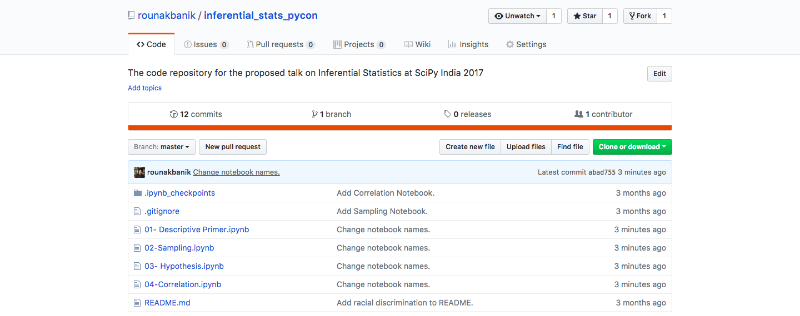
github.com/rounakbanik/inferential_stats_pycon

Slide 3
Contents
Descriptive Statistics Primer Central Tendencies, Measures of Spread, Binomial and Normal Distributions, Normalcy Test, Z-Scores and p-values.
Sampling Estimation of Population Proportion and Mean, The Central Limit Theorem
Hypothesis Testing and Statistical Tests Null and Alternate Hypotheses, One and Two Sample Significance Tests, Chi-Squared Significance Tests
Ethics and Standards in Inferential Statistics Sampling Bias, Statistical v/s Practical Significance, Misusing p-values

Slide 4
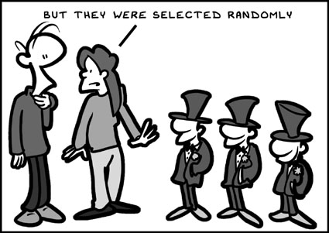
Sampling

Slide 5

Credit Card Frauds

Slide 6

Olympian Weights

Slide 7
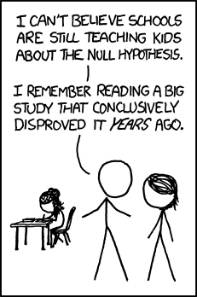
Hypothesis Testing

Slide 8
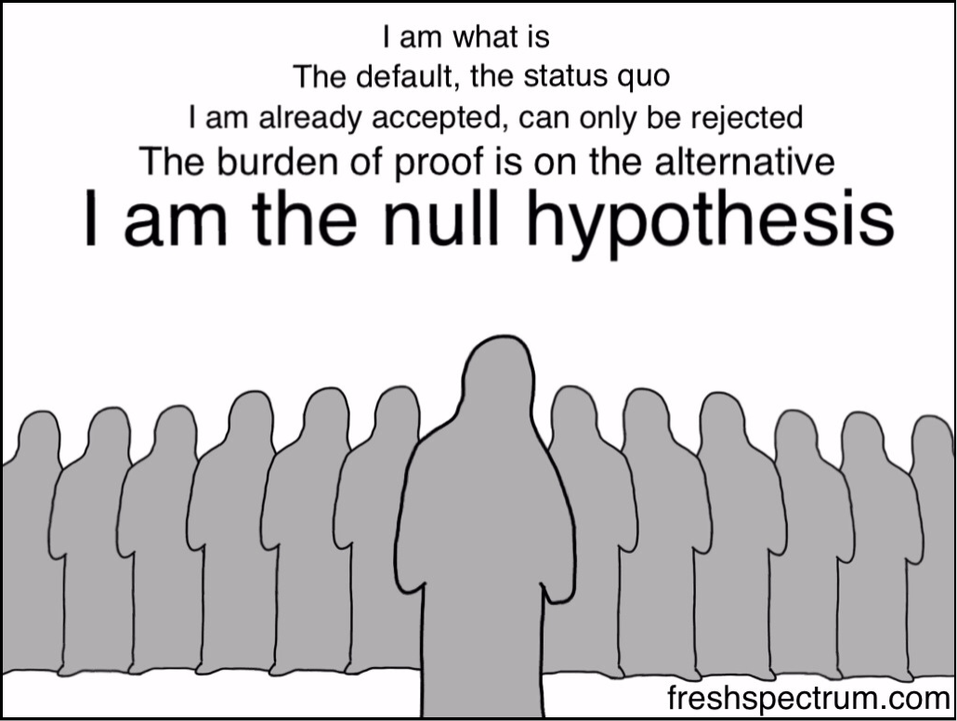
Terminology
Null and Alternate Hypotheses
Significance Level
Statistical Test
P-Values

Slide 9
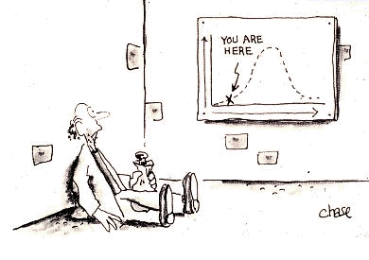
Steps
Formulate the Null and the Alternate Hypothesis.​
Decide on the Statistical Test to use.​
Calculate the p-value​
Compare p-value to the significance level, alpha. Reject/Accept Null Hypothesis based on the comparison.
Summarize the result

Slide 10

Suicide by Gender
In India, are men as likely as women to commit suicide?

Slide 11

NBA Player Heights
What is the average height of NBA players?

Slide 12

Literacy Rates
How do the literacy rates in Delhi and Punjab compare?

Slide 13

Airbnb Destinations
Do men and women prefer certain countries for Airbnb bookings?

Slide 14

Racial Discrimination
Are blacks as likely to get an interview call as whites?

Slide 15
Ethics and Standards

Slide 16

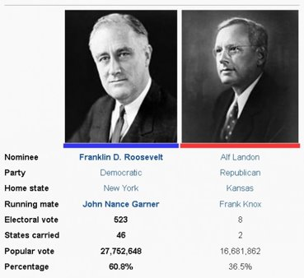
Quality and Quantity

Slide 17
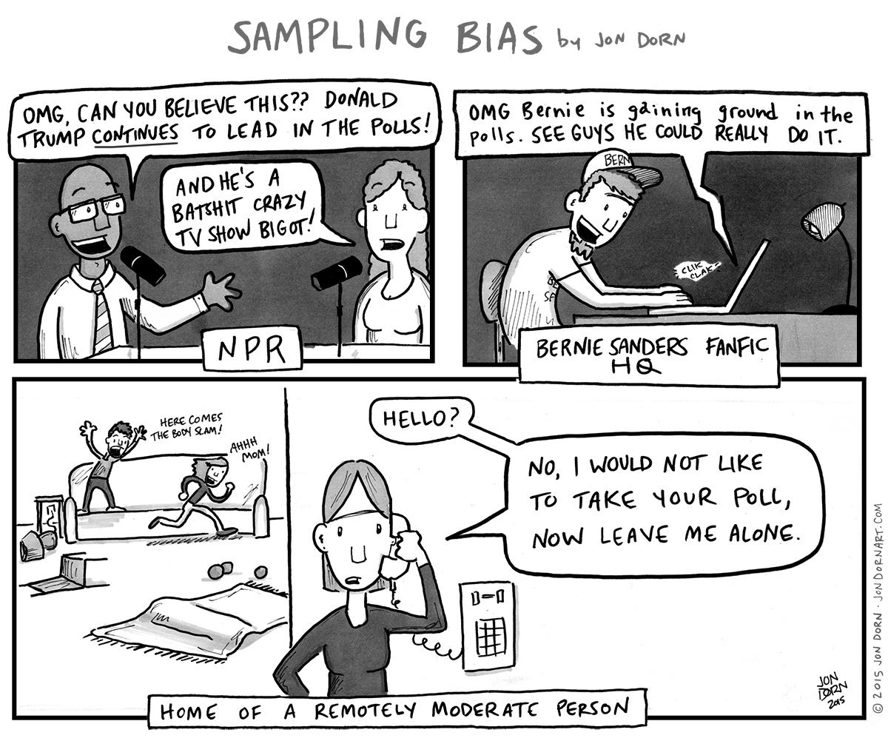
Sampling Bias
Deterministic bias​
Small number of observations​
Selection bias​
Confirmation bias​
Inaccuracy

Slide 18

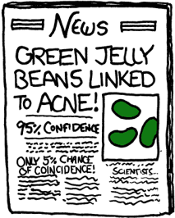
Statistical and Practical Significance

Slide 19
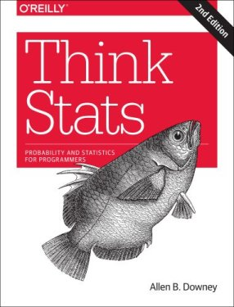
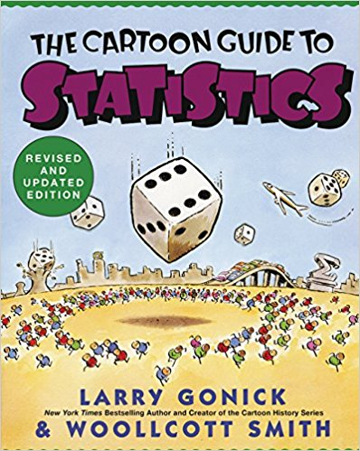

Further Reading

Slide 20
The End
Any Questions?

